Slide 1
Version Control

Slide 2
What is version control?
Version control systems are a category of software tools that help a software team manage changes to source code over time. Version control software keeps track of every modification to the code in a special kind of database.
If a mistake is made, developers can turn back the clock and compare earlier versions of the code to help fix the mistake while minimizing disruption to all team members.

Slide 3
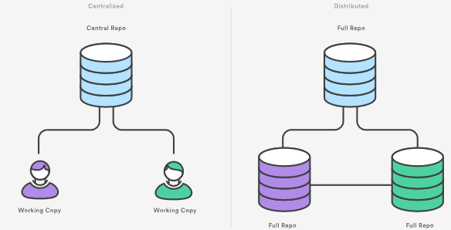
What is Git?
By far, the most widely used modern version control system in the world today is Git.
Git is a distributed version control system.

Slide 4
Setting up a repository
git init / git clone / git config

Slide 5
Configure git: git config
git config --global user.email ”username@host.com”
git config --global user.name “username”

Slide 6
Initializing a new repository: git init
cd /path/to/your/existing/code
git init
To create a new repo, you'll use the git init command. git init is a one-time command you use during the initial setup of a new repo.
Executing this command will create a new .git subdirectory in your current working directory. This will also create a new master branch.
git init <project directory>

Slide 7
Cloning an existing repository: git clone
git clone <repo url>
If a project has already been set up in a central repository, the clone command is the most common way for users to obtain a local development clone.
Git supports a few different network protocols and corresponding URL formats.
When executed, the latest version of the remote repo files on the master branch will be pulled down and added to a new folder.

Slide 8
Saving changes to the repository: git add and git commit
cd /path/to/project
echo "test content for git tutorial" >> CommitTest.txt
git add CommitTest.txt
git commit -m "added CommitTest.txt to the repo"
After executing this example, your repo will now have CommitTest.txt added to the history and will track future updates to the file.
Another common use case for git add is the --all option. Executing git add --all will take any changed and untracked files in the repo and add them to the repo and update the repo's working tree.

Slide 9
Bare vs. cloned repositories
If you used git clone in the previous "Initializing a new Repository" section to set up your local repository, your repository is already configured for remote collaboration.
git clone will automatically configure your repo with a remote pointed to the Git URL you cloned it from. This means that once you make changes to a file and commit them, you can git push those changes to the remote repository.
If you used git init to make a fresh repo, you'll have no remote repo to push changes to. A common pattern when initializing a new repo is to go to a hosted Git service like GitHub and create a repo there. The service will provide a Git URL that you can then add to your local Git repository and git push to the hosted repo.

Slide 10
Repo-to-repo collaboration: git push
Once you have a remote repo setup, you will need to add a remote repo url to your local git config, and set an upstream branch for your local branches. The git remote command offers such utility.
git remote add <remote_name> <remote_repo_url>
This command will map remote repository at <remote_repo_url> to a ref in your local repo under <remote_name>. Once you have mapped the remote repo you can push local branches to it.
git push -u <remote_name> <local_branch_name>
This command will push the local repo branch under <local_branc_name> to the remote repo at <remote_name>.

Slide 11
Configuration & set up: git config
In addition to configuring a remote repo URL, you may also need to set global Git configuration options such as username, or email. The git config command lets you configure your Git installation (or an individual repository) from the command line.
Git stores configuration options in three separate files, which lets you scope options to individual repositories (local), user (Global), or the entire system (system):
Local: <repo>/.git/config – Repository-specific settings.
Global: /.gitconfig – User-specific settings. This is where options set with the --global flag are stored.
System: $(prefix)/etc/gitconfig – System-wide settings.

Slide 12
Configuration & set up: git config
Define the author name to be used for all commits in the current repository. Typically, you’ll want to use the --global flag to set configuration options for the current user.
git config --global user.name <name>
Adding the --local option or not passing a config level option at all, will set the user.name for the current local repository.
git config --local user.email <email>

Slide 13
Configuration & set up: git config
Once you have a remote repo setup, you will need to add a remote repo url to your local git config, and set an upstream branch for your local branches. The git remote command offers such utility.
git remote add <remote_name> <remote_repo_url>
This command will map remote repository at <remote_repo_url> to a ref in your local repo under <remote_name>. Once you have mapped the remote repo you can push local branches to it.
git push -u <remote_name> <local_branch_name>
This command will push the local repo branch under <local_branc_name> to the remote repo at <remote_name>.

